Slide 1

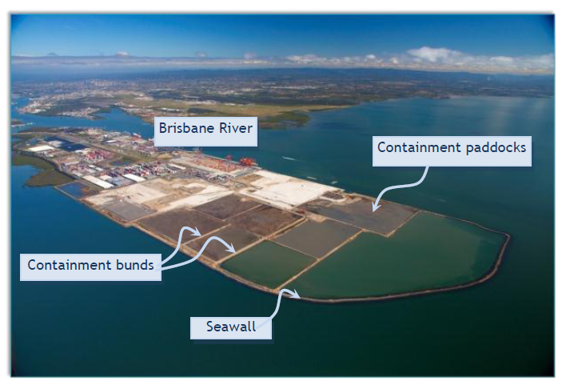
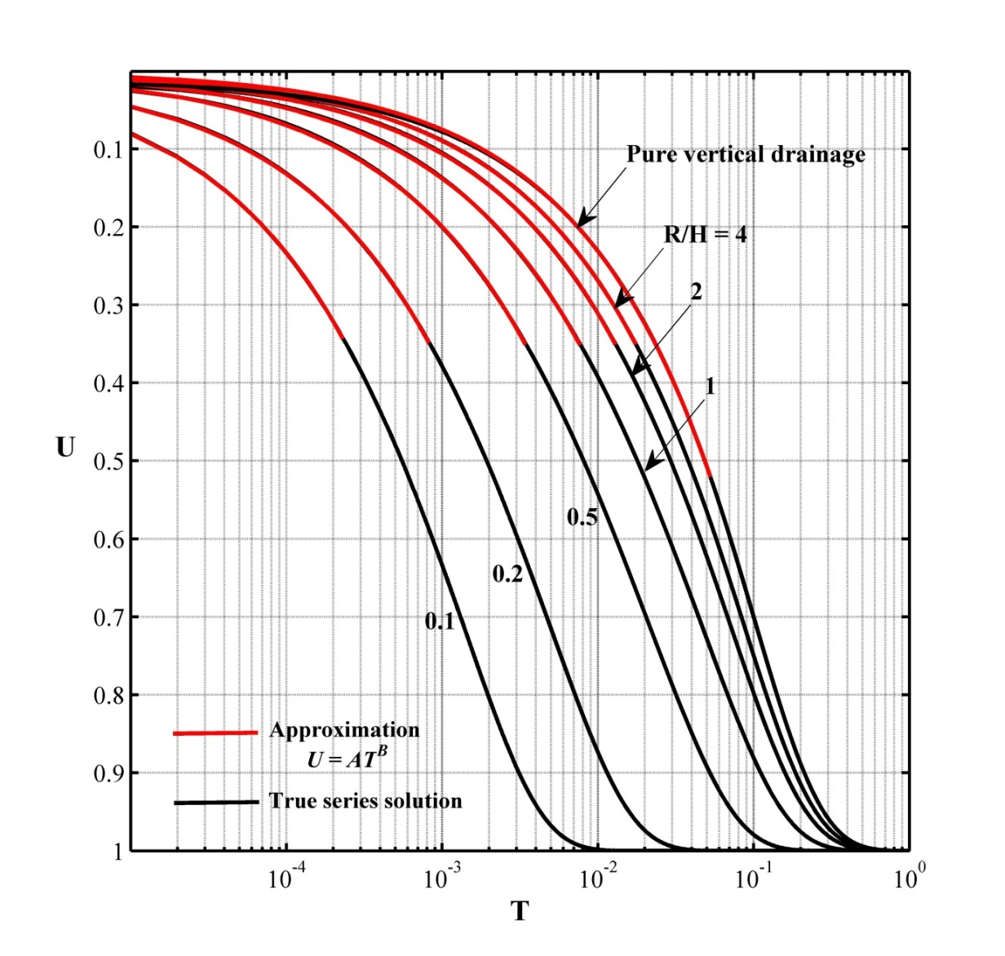
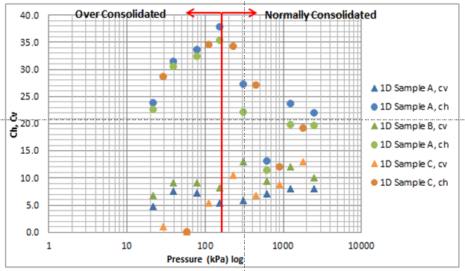
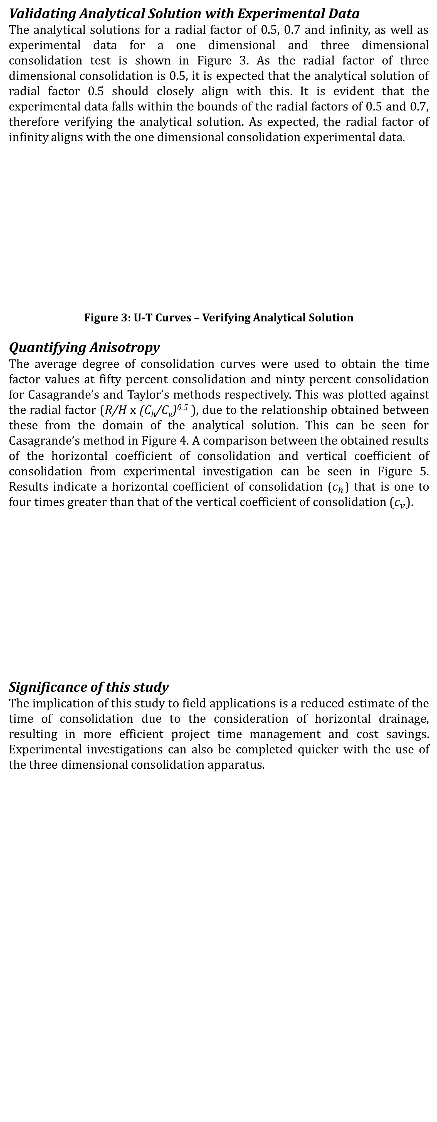
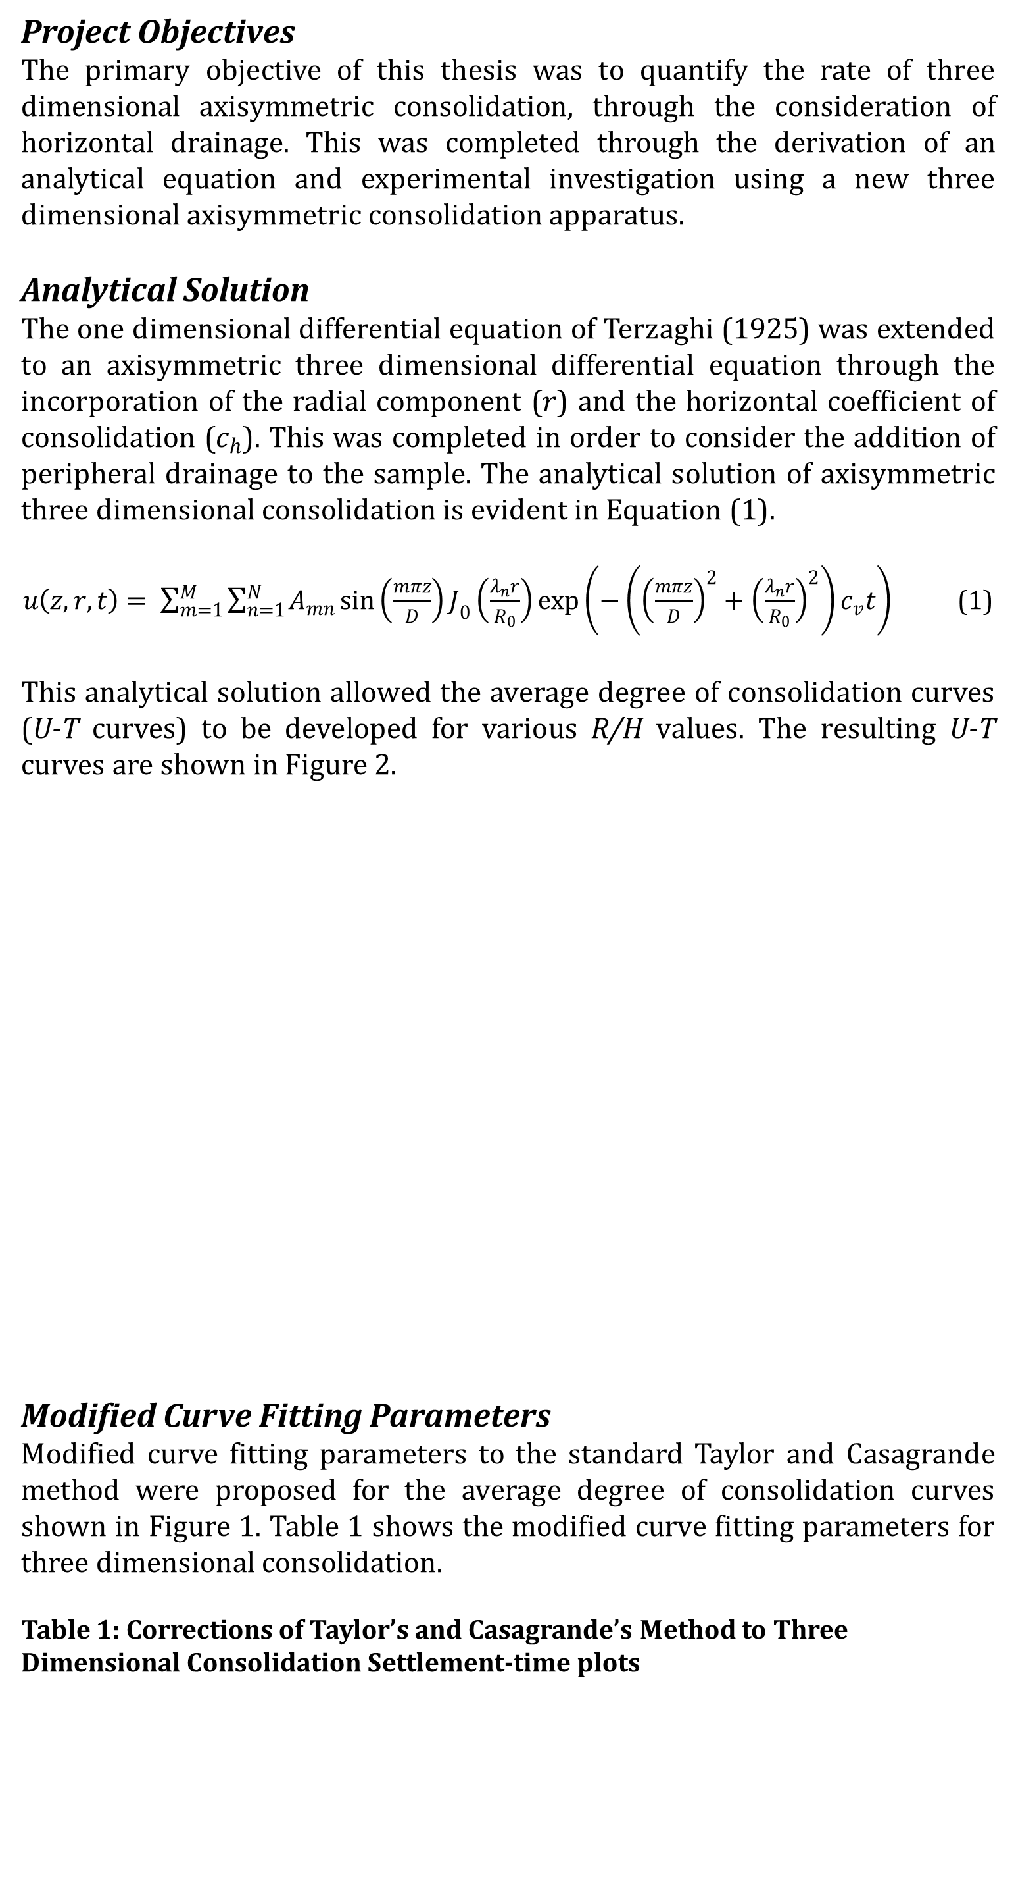
Quantifying the Rate of Three Dimensional Consolidation
Thesis completed by Samantha Thomas.
Email: samantha.thomas@my.jcu.edu.au
References:
Terzaghi, K. (1925). Erdbaumechanik auf bodenphysikalischer Grundlage. F. Deuticke Vienna.
Lovisa, J., Thomas, S., Macdonald, S. & Sivakugan, N. (2014). "A Method to Determine ch using Three Dimensional Consolidation " ASTM Geotechnical Testing Journal.
Ganesalingam, D., Ameratunga, J., Scweitzer, G., Boyle, P. & Sivakugan, S. Anisotropy in the permeability and consolidation characteristics of dredged mud. ANZ 2012 Conference Proceedings. Ground Engineering in a Changing World: 11th Australia - New Zealand Conference on Geomechanics 2012a Melbourne, VIC, Australia pp. 752-757.
Samantha Thomas – Civil Engineering
The Port of Brisbane
The Port of Brisbane is currently undertaking a land reclamation project, which utilises dredged materials as fill, providing both economic and environmental benefit.
Unfortunately, the dredged material is comprised of silts and clays in a slurry form with extremely high water content, resulting in poor drainage properties. The containment bunds are underlain by a Holocene clay layer of up to 30 m in depth, further underlain by an extremely stiff Pleistocene. This results in both the dredged material and in situ material having poor drainage properties and high compressibility (Ganesalingam et al. 2012a).
Due to the limitations in consolidation theory, where the rate of consolidation is generally quantified using one dimensional consolidation theory, the estimation of the rate of settlement is difficult, with the time taken for consolidation to be achieved often overestimated. Generally an increased cost is involved as a result of the overestimated time of settlement. This highlights the importance and necessity of the time rate three dimensional consolidation to be quantified.
Figure 1: Aerial view of land reclamation at the Port of Brisbane (Ganesalingam et al. 2012a)
Introduction
Consolidation is the compression of a soil stratum that occurs due to the application of stress, and as a result of the dissipation of water from voids in a saturated soil. Consolidation settlement can result in many problems for structures built upon a consolidating layer, and therefore correct estimation of the magnitude and rate of the settlement is required.
Geotechnical engineers generally quantify the coefficient of consolidation using the one dimensional consolidation theory of Terzaghi (1925), assuming drainage and strain occurs in the vertical plane only. As many field scenarios actually experience drainage in both the vertical and horizontal directions (two and three dimensional consolidation), the rate of consolidation that occurs in these situations is greater than that assumed when using one dimensional consolidation theory.
Project Objectives
The primary objective of this thesis was to quantify the rate of three dimensional axisymmetric consolidation, through the consideration of horizontal drainage. This was completed through the derivation of an analytical equation and experimental investigation using a new three dimensional axisymmetric consolidation apparatus.
Analytical Solution
The one dimensional differential equation of Terzaghi (1925) was extended to an axisymmetric three dimensional differential equation through the incorporation of the radial component ($r$) and the horizontal coefficient of consolidation ($c_{h}$). This was completed in order to consider the addition of peripheral drainage to the sample. The analytical solution of axisymmetric three dimensional consolidation is evident in Equation (1).
$u\left(z,r,t\right)= \sum_{m=1}^{M}{\sum_{n=1}^{N}{A_{mn}\sin\left(\frac{mπz}{D}\right)J_{0}\left(\frac{λ_{n}r}{R_{0}}\right)\exp\left(−\left({\left(\frac{mπz}{D}\right)}^{2}+{\left(\frac{λ_{n}r}{R_{0}}\right)}^{2}\right)c_{v}t\right)}}$ (1)
This analytical solution allowed the average degree of consolidation curves (U-T curves) to be developed for various R/H values. The resulting U-T curves are shown in Figure 2.
Modified Curve Fitting Parameters
Modified curve fitting parameters to the standard Taylor and Casagrande method were proposed for the average degree of consolidation curves shown in Figure 1. Table 1 shows the modified curve fitting parameters for three dimensional consolidation.
Table 1: Corrections of Taylor’s and Casagrande’s Method to Three Dimensional Consolidation Settlement-time plots
Validating Analytical Solution with Experimental Data
The analytical solutions for a radial factor of 0.5, 0.7 and infinity, as well as experimental data for a one dimensional and three dimensional consolidation test is shown in Figure 3. As the radial factor of three dimensional consolidation is 0.5, it is expected that the analytical solution of radial factor 0.5 should closely align with this. It is evident that the experimental data falls within the bounds of the radial factors of 0.5 and 0.7, therefore verifying the analytical solution. As expected, the radial factor of infinity aligns with the one dimensional consolidation experimental data.
Figure 3: U-T Curves – Verifying Analytical Solution
Quantifying Anisotropy
The average degree of consolidation curves were used to obtain the time factor values at fifty percent consolidation and ninty percent consolidation for Casagrande’s and Taylor’s methods respectively. This was plotted against the radial factor (R/H x (C_{h}/C_{v})^{0.5} ), due to the relationship obtained between these from the domain of the analytical solution. This can be seen for Casagrande’s method in Figure 4. A comparison between the obtained results of the horizontal coefficient of consolidation and vertical coefficient of consolidation from experimental investigation can be seen in Figure 5. Results indicate a horizontal coefficient of consolidation ($c_{h}$) that is one to four times greater than that of the vertical coefficient of consolidation ($c_{v}$).
Significance of this study
The implication of this study to field applications is a reduced estimate of the time of consolidation due to the consideration of horizontal drainage, resulting in more efficient project time management and cost savings. Experimental investigations can also be completed quicker with the use of the three dimensional consolidation apparatus.
T50 Values
T90 Values
Figure 2: Average Degree of Consolidation Curves for Varying R/H Ratios (Lovisa et al. 2014)
Figure 4: Quantifying Anisotropy using Modified Time Factors – Casagrande’s Method (Lovisa et al. 2014)
Figure 5: Comparison between cv and ch– Casagrande’s Method
 |  |  | Casagrande's Method |  | Taylor's Method
R/H | ch/cv | Domain | fc | T50 | fT | B | T90
10000000 | 0 | 52.1 | 4 | 0.049 | 1.15 | 0.5 | 0.212
0.5 | 4 | 23 | 4.38 | 0.008 | 1.43 | 0.47 | 0.052

